Slide 1

ESP 106 – Lecture 3
for and while loops, if else statements, and functions
Into the coding vortex!

Slide 2
Outline
for and while loops
Conditional statements (if and else)
Functions

Slide 3

Computers are Great at Repetition!

Slide 4
for and while Loops
Allow you to write code just once and then tell R to do it many many times
for loops:
Repeat instructions for n number of cases
while loops:
Repeat instructions until a certain condition is met

Slide 5
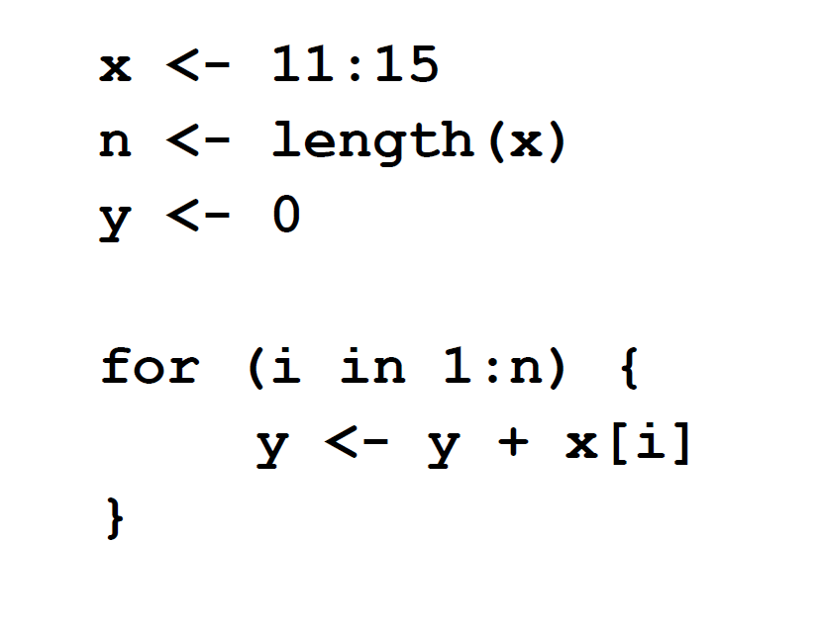
for Loop Syntax
Tell R this is a for loop using for
Defining Variables
for Loop
Define a variable for use in the for loop. Often we use i but it can be anything not already in use as a variable

Slide 6
for Loop Syntax
Tell R what values your variable should take iteratively the for loop using in followed by a vector of values
Define the start and end of the for loop using brackets
Code within the loop is indented making it easy to understand what code is being repeated. RStudio will do this automatically
Code to run for each value of i
NOTE – your index variable (i in this case) should appear somewhere in this code. Otherwise exactly the same thing will run every time!

Slide 7
for Loop Syntax
Reading the code, can you tell what this for loop is doing?

Slide 8
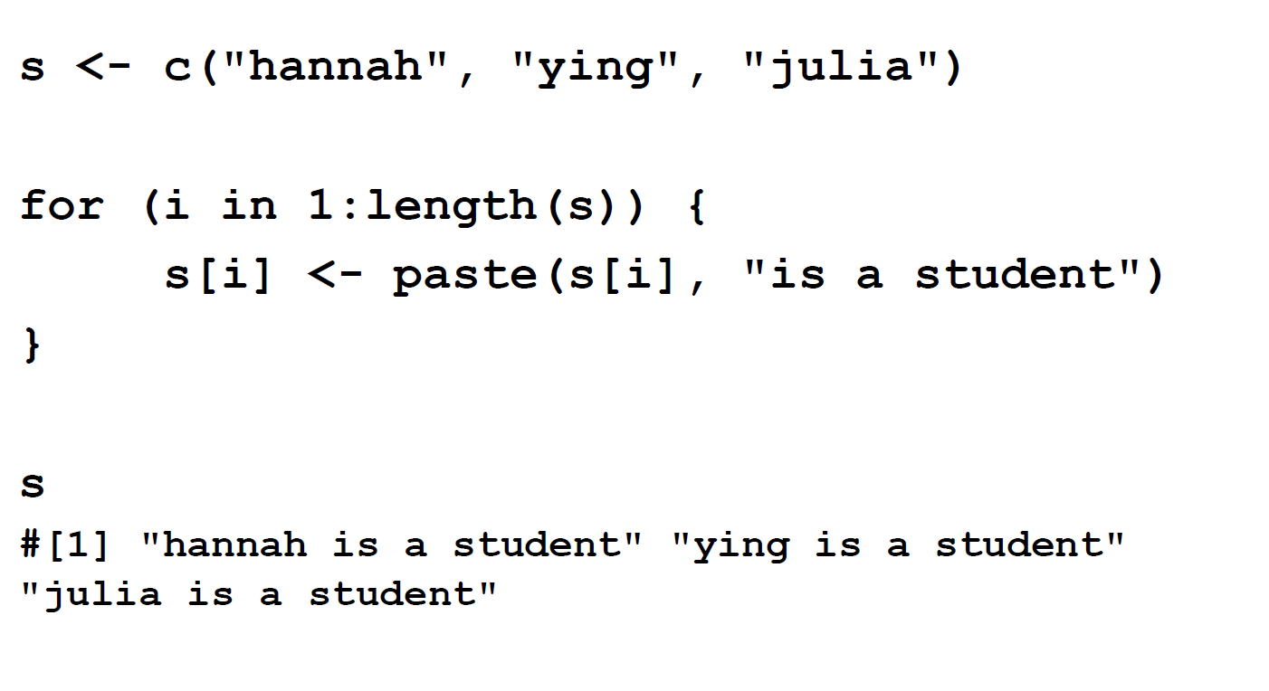
for Loop Example – what is this one doing?

Slide 9
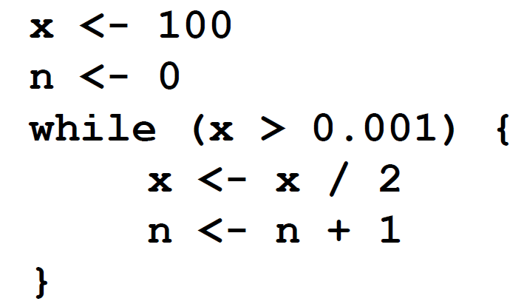
while Loops
for loops require you to specify the values you want to loop over
Sometimes instead you just want to keep going until a certain condition is met – this is where while loops are useful
Condition returning TRUE or FALSE using variable modified in the while loop code
Computer will keep running while loop until condition is FALSE
Define while loop using brackets just like a for loop

Slide 10
Outline
for and while loops
Conditional statements (if and else)
Functions

Slide 11
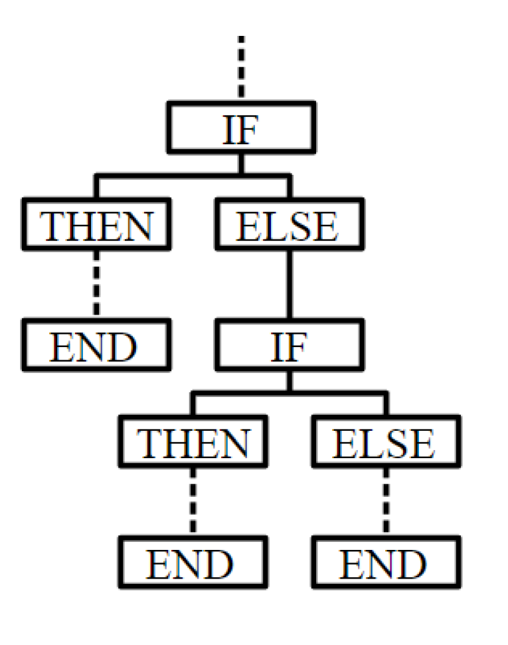
Conditional Statements
Sometimes we want the computer to do one thing under certain conditions and something else under other conditions
Use statements if and else to create branches so that different code runs under some conditions and other code runs under other conditions

Slide 12
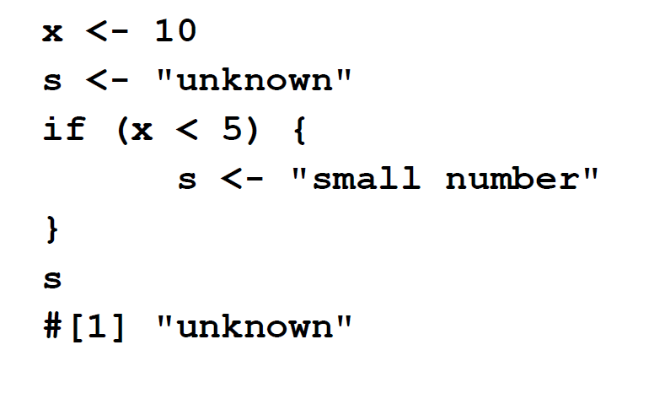
if Syntax
Condition returning TRUE or FALSE
Use if to start the if statement
Using if will only run code within the brackets if the condition is met
Different from while loop because there is no looping, code will only run once if condition is met
Begin and end conditional code using brackets
Conditional code is indented like in loops

Slide 13
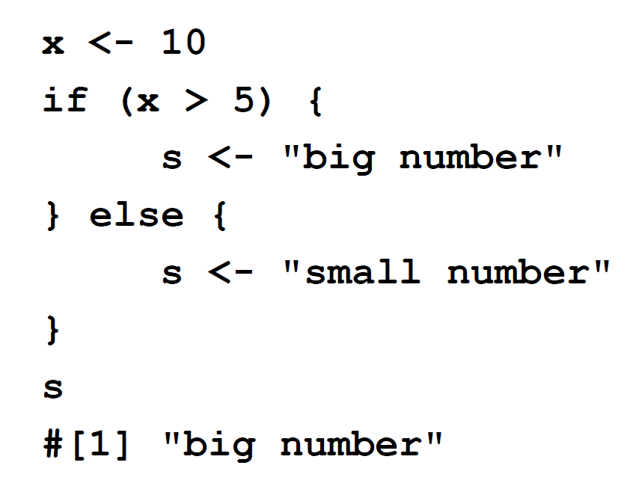
if else Syntax
Code to run if condition is true
Often we want to run some code if a condition is true and different code if the condition is false
Using an if statement followed by and else statement is a concise way of doing this
Code to run if condition is false
else comes right after end of if statement

Slide 14
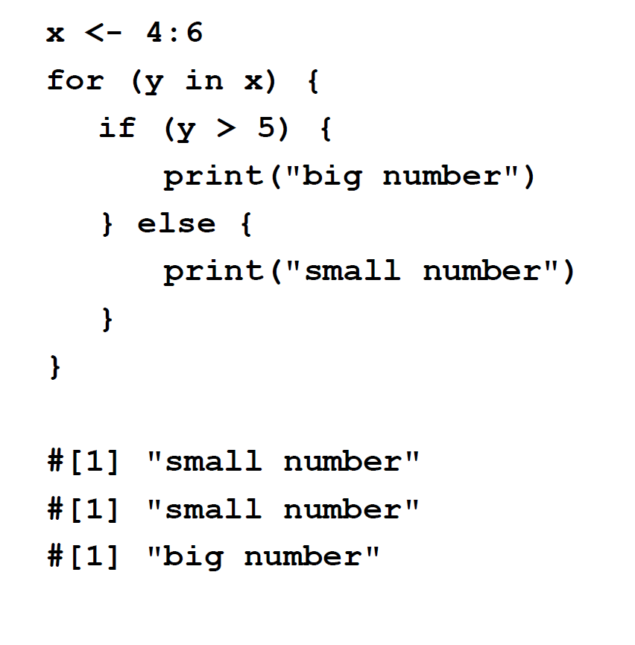
if else example in a for loop
Notice this line is intended twice, meaning it is in both the for loop and the if statement

Slide 15
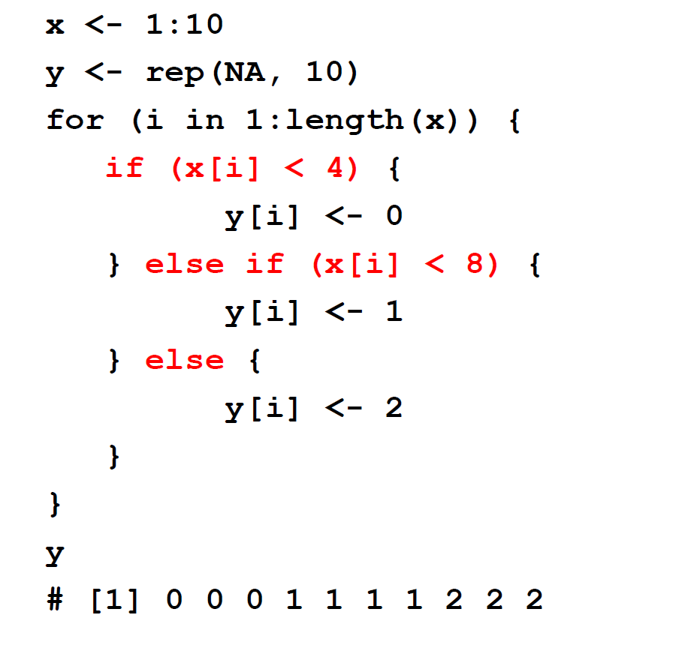
if – else if - else
Use else if to add additional conditions to the code
Do this if x[i] is less than 4
Do this if x[i] is greater than 4 but less than eight
Do this if other conditions are not met (i.e. x[i]>=8)

Slide 16
Outline
for and while loops
Conditional statements (if and else)
Functions

Slide 17
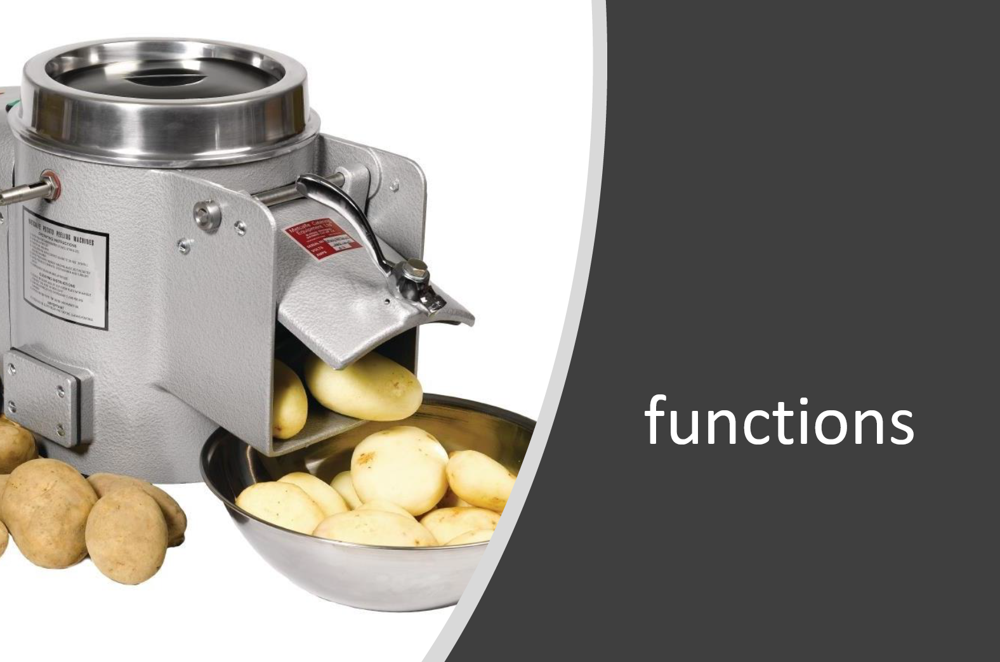
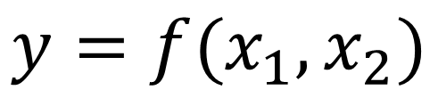
Functions
Sometimes there is code we want to run many times in different contexts
Functions allow us to package up code so that we can do the same transformations many times
Functions take in arguments, do a transformation on those arguments and return the result as output
$$y=f(x_{1},x_{2})$$
Function output
Function with
2 arguments
Arguments

Slide 18
Functions in R
R comes with many pre-written functions created by other people. There are tons of packages that have other functions people have made available
These functions expect you to provide them with information and will return output in a certain format.
Documentation of this information to help users understand what the function is doing must be provided by people writing functions for R (and in general documenting functions is good coding practice)
What are some examples of functions we saw last week?
Type ?functionname into the R Console to bring up the documentation for that function

Slide 19
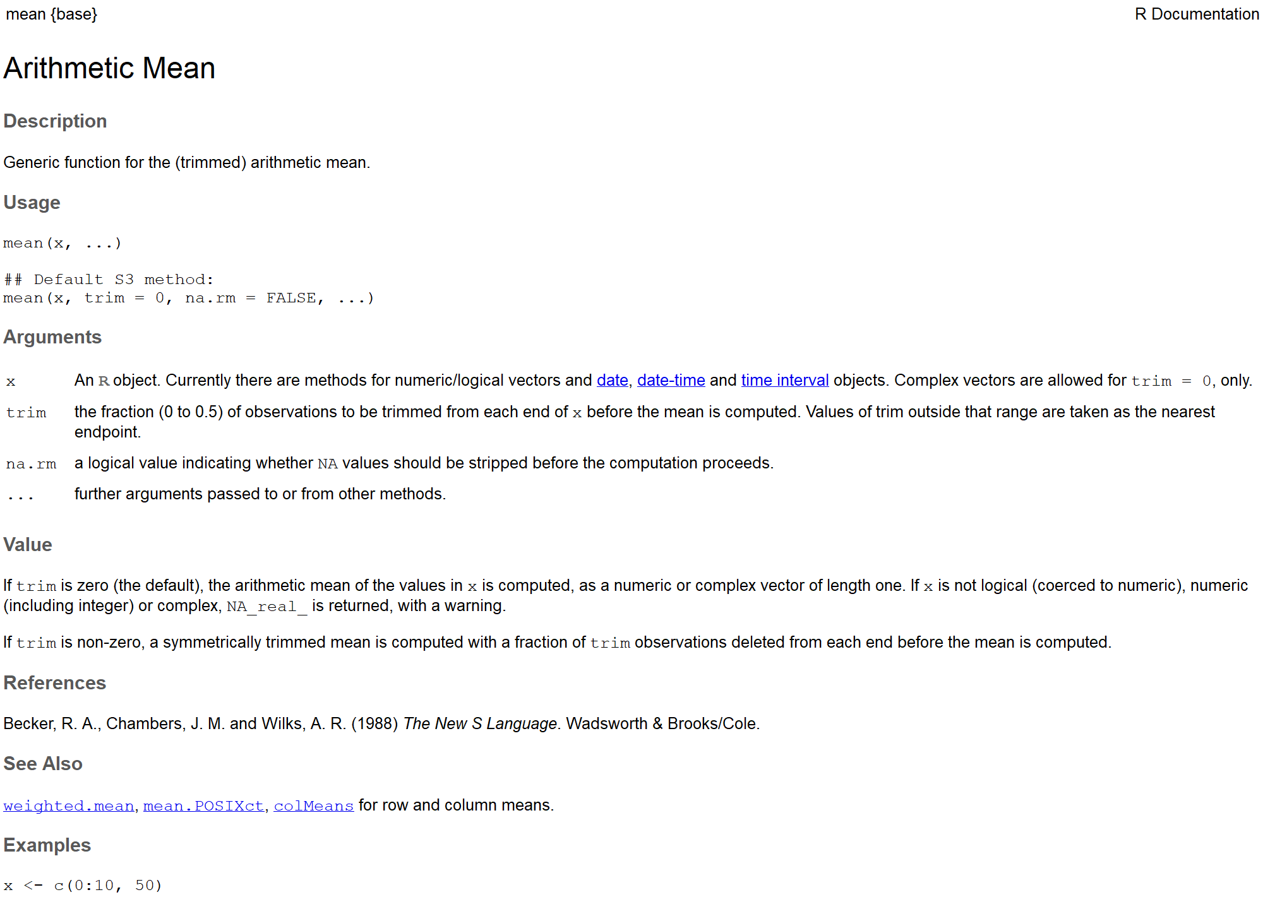
Arguments the function can accept
If the argument has an equals sign followed by a value, this is the function default that will be assumed if you don’t specify that argument

Slide 20
Description of what the arguments mean

Slide 21
Description of what the function is doing and what output it is returning

Slide 22
Example code showing how to use the function

Slide 23
Function Arguments
Some functions are very complex and have lots of arguments. But often you as the user don’t need to specify them all because default values are fine
R will accept either:
multiple arguments separated by commas, in which case R assumes that they are arguments corresponding to the order given in the documentation
named arguments using f(name=value) where the name is given in the function documentation
For example mean(c(4,5,79), 0, TRUE) and mean(x= c(4,5,79), na.rm=TRUE) will give the same values – notice how the second version omits the “trim” argument and therefore just accepts the default value

Slide 24
Writing Your Own Functions
R also allows you to write your own functions
If you need to do something particular (i.e. for which there is not any pre-written function) many times it is often useful to write your own function

Slide 25
Function Syntax
What you want to name the function
Ideally something informative about what the function does
your_function_name = function (arg1 = arg1_default, arg2 = arg2_default){
your function’s code here
return(your_function_output)
}

Slide 26
Function Syntax
Use function() to begin defining the function
your_function_name = function (arg1 = arg1_default, arg2 = arg2_default){
your function’s code here
return(your_function_output)
}

Slide 27
Function Syntax
your_function_name = function (arg1 = arg1_default, arg2 = arg2_default){
your function’s code here
return(your_function_output)
}
Specify argument to the function
You can provide default values for the arguments
Arguments without defaults must be provided by the user
Always specify arguments without defaults before arguments with defaults

Slide 28
Function Syntax
your_function_name = function (arg1 = arg1_default, arg2 = arg2_default){
your function’s code here
return(your_function_output)
}
Start and end the function using brackets, as with for loops, if statements etc.

Slide 29
Function Syntax
your_function_name = function (arg1 = arg1_default, arg2 = arg2_default){
your function’s code here
return(your_function_output)
}
Code that transforms arguments supplied by the user
Think of the code here as its own mini environment
Only variables referenced within the function should be those specified as arguments within the function, or defined in the function itself

Slide 30
Function Syntax
your_function_name = function (arg1 = arg1_default, arg2 = arg2_default){
your function’s code here
return(your_function_output)
}
A return statement tells the function what objects should be returned to the user when the function is run
by default, if there is no return statement, the function will return the result of the last line of code

Slide 31
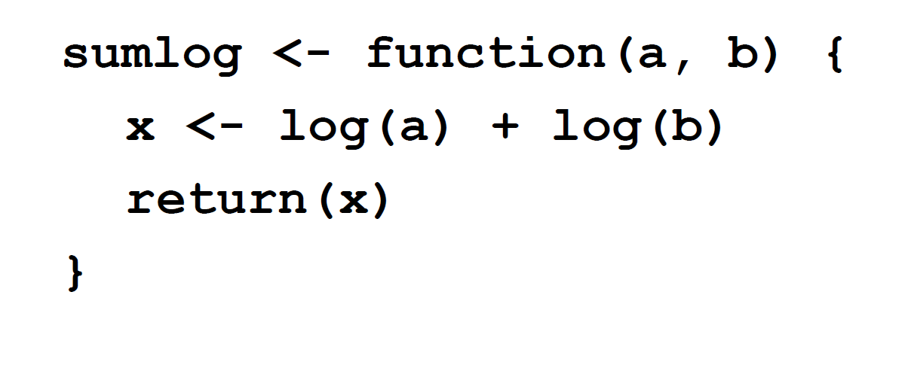
Example
Function to Return the Sum of the Log of Two Numbers

